Slide 1



Deep Learning-Based DDoS-Attack Detection for Cyber–Physical System Over 5G Network
A Deep Learning Approach to 5G Cybersecurity
Department: School of Cyber Security and Digital Forensics
Program: M.Tech Artificial Intelligence & Data Science
(Specialization in Cyber Security Specialization)
Year / Sem: 1st / 2nd - Session: 2024-26
Subject Name: Advanced Machine Learning for Cyber Security and Forensics
Subject Code: CTMTAIDS SII P1
Guided By: Dr. Ahlad Kumar Sir
Presented by: Enrolment No.: | Pratham Badge 2401003007003 | Suraj Verma 2401003007012 | Amit Gupta 2401003007023

Slide 2
Paper Highlights
Authors: B. Hussain, Q. Du, B. Sun, Z. Han
Journal: IEEE Transactions on Industrial Informatics, Feb 2021
Goal: Efficient DDoS detection using Deep Learning (CNN & BLSTM)
Key Contribution: Real-time detection for CPS in 5G
DOI: 10.1109/TII.2020.2974520

Slide 3
Problem Statement: DDoS Detection in 5G Network Slices
5G connects billions of devices, increasing the attack surface.
Network slicing creates isolated yet interdependent segments.
Real-time applications need ultra-fast protection.
Traditional DDoS detection is too slow and rule-based.
Encrypted and dynamic traffic bypasses static filters.
CNNs offer fast, adaptive, lightweight, and accurate detection.

Slide 4
Objectives
Design and implement a CNN-based model to detect DDoS attacks in 5G networks.
Focus on protecting network slices in Cyber–Physical Systems (CPS).
Train a binary classifier to distinguish between benign and malicious traffic.
Achieve high accuracy, precision, and low false positives.
Integrate the solution into Software Defined Networking (SDN) and Network Function Virtualization (NFV) environments.

Slide 5

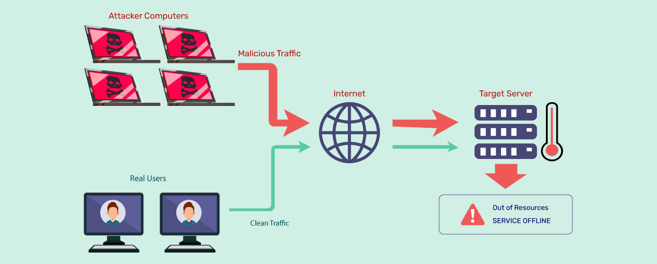
Introduction - DDoS
🧩 What is a DDoS Attack?
DDoS (Distributed Denial-of-Service) attacks overwhelm a system or network with massive traffic.
Aim to make a service or network resource unavailable to legitimate users.
Widely used in cyber warfare, botnets, and extortion campaigns.
Real-World Consequences:
Service Outages
Financial Losses
Data Breach Risk
Customer Trust Damage
Degraded Performance

Slide 6

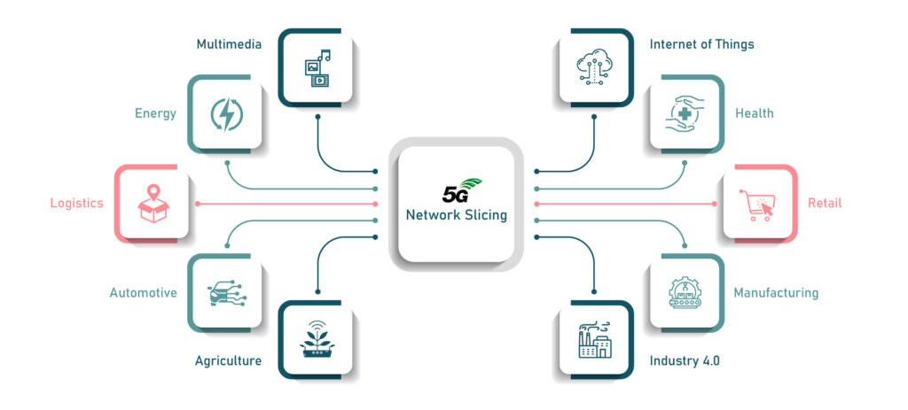
Introduction – 5G
📡 Why is 5G Vulnerable?
5G offers ultra-reliable, low-latency communication and massive device connectivity.
Network slicing enables customized virtual networks—but also increases the attack surface.
The real-time nature of 5G requires instant threat detection and response.
📡 Why 5G ?
More Speed, More Devices, More Risk
Massive Attack Surface
Network Slicing Makes It Worse
Edge Computing & AI Need Real-Time Security

Slide 7

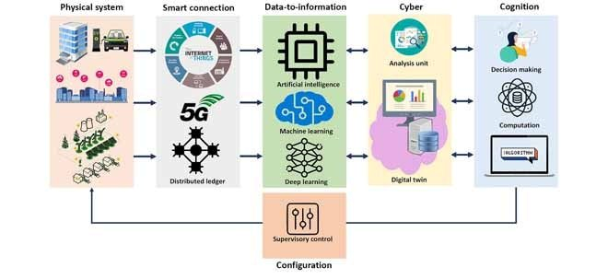
Introduction - CPS
🖥️ What is Cyber Physical System?
Integrations of computation, networking, and physical processes..
5G enables CPS to operate in real time with ultra-low latency and high reliability.
Common in smart grids, healthcare, industrial IoT, autonomous vehicles, and critical infrastructure..
🖥️ Importance of CPS?
Critical Infrastructure Backbone
Healthcare & Life-Critical Systems
Autonomous & Smart Transportation
Real-Time Operation Requirements
Target of Cyber Attacks

Slide 8

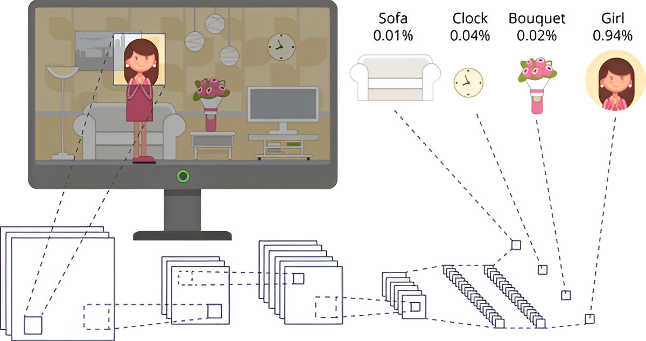
Introduction - CNN
🧠 Why Use Deep Learning (CNN)?
Traditional ML techniques struggle with dynamic patterns in 5G data.
CNNs can automatically extract spatial and temporal features from network traffic.
Achieve higher accuracy, lower false positives, and better generalization.
🧠 What is CNN?
A Convolutional Neural Network (CNN) is a type of deep learning model designed to automatically extract patterns from data originally for images ,but now used widely for network traffic, time-series, and anomaly detection too.

Slide 9
🔍 Key Components of CNN:
Layer | Function
🧱 Convolution Layer | Extracts features using filters (kernels) from the input data.
🎛️ Activation (ReLU) | Introduces non-linearity (e.g., detects complex attack patterns).
🌀 Pooling Layer | Reduces feature size, improves performance, and focuses on key info.
🧩 Flatten Layer | Converts feature maps into a 1D vector for prediction.
🎯 Fully Connected Layer | Final decision-making (e.g., DDoS = 0, Benign = 1)

Slide 10
CNN Architecture
Input Layer:
Data: Features extracted from network traffic (e.g., flow duration, packet lengths, protocols).
Shape: (number of samples, number of features, 1)
Convolution Layers:
Apply filters (kernels) to extract spatial features from the input.
Purpose: Detect patterns like traffic spikes or irregularities, potentially indicating DDoS attacks.
Activation Function (ReLU):
Introduces non-linearity to detect complex patterns that simpler models may miss.
Pooling Layer (Optional):
Reduces spatial dimensions, keeping only essential features.
Benefit: Improves performance and reduces overfitting.

Slide 11
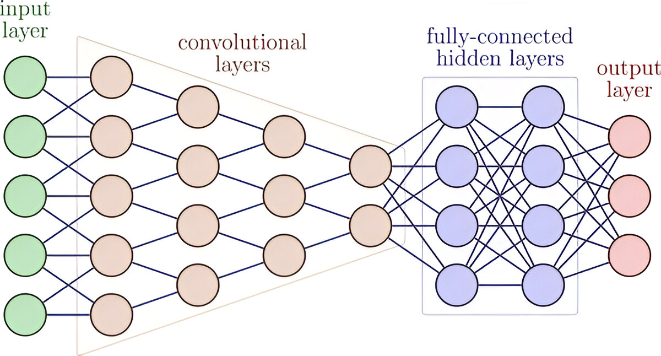
CNN Architecture
Flattening Layer:
Converts 2D features (from convolution and pooling) into a 1D vector for classification.
Fully Connected Layer:
Neurons in this layer are connected to all the previous layer’s neurons.
Purpose: Final classification (DDoS or benign traffic).
Output Layer:
Sigmoid activation function for binary classification:
0 = Attack
1 = Benign

Slide 12
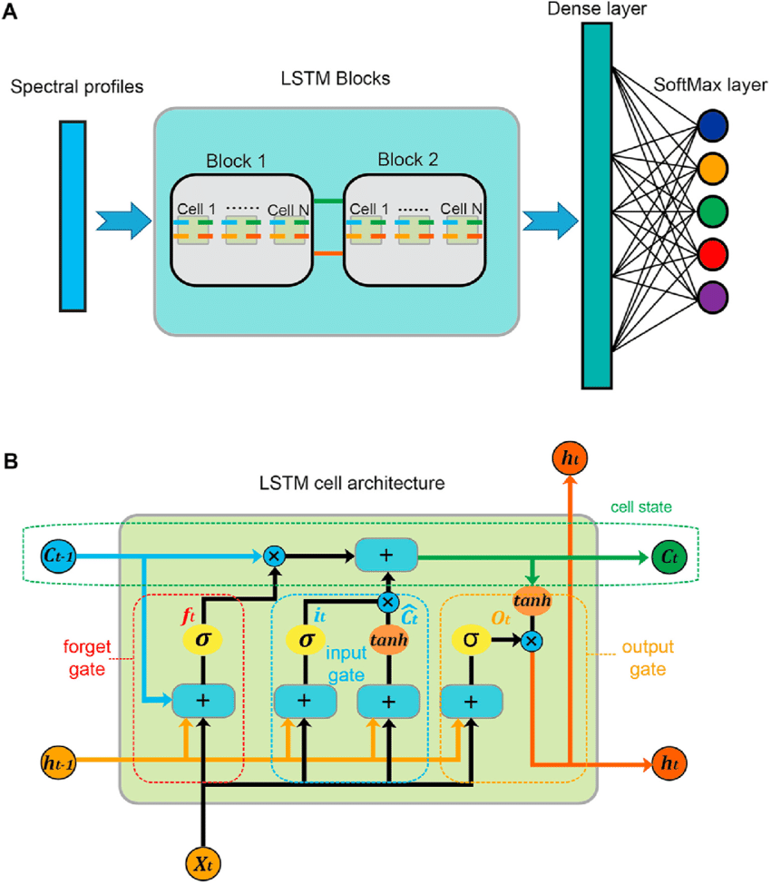
LSTM Architecture
An advanced Recurrent Neural Network (RNN) variant, excel at capturing long-term dependencies in sequential data, essential for detecting temporal DDoS patterns in 5G traffic.
Key Components:
Cell State:
A persistent memory conduit that retains critical information across time steps, enabling long-term context retention.
Forget Gate:
Selectively discards irrelevant data using a sigmoid function (σ(W_{f} * [h_{t-1}, x_{t}] + b_{f})).
Input Gate:
Regulates new information addition via sigmoid (σ(W_{i} * [h_{t-1}, x_{t}] + b_{i})) and tanh (W_C * [h_{t-1}, x_{t}] + b_{C})) activation.
Output Gate:
Filters the cell state to produce output using sigmoid (σ(W_{o} * [h_{t-1}, x_{t}] + b_{o})) and tanh(C_{t}).
Cell State:
A persistent memory conduit that retains critical information across time steps, enabling long-term context retention.
Forget Gate:
Selectively discards irrelevant data using a sigmoid function (σ(W_{f} * [h_{t-1}, x_{t}] + b_{f})).
Input Gate:
Regulates new information addition via sigmoid
(σ(W_{i} * [h_{t-1}, x_{t}] + b_{i})) and tanh (W_C * [h_{t-1}, x_{t}] + b_{C})) activation.
Output Gate:
Filters the cell state to produce output using sigmoid
(σ(W_{o} * [h_{t-1}, x_{t}] + b_{o})) and tanh(C_{t}).

Slide 13
System Architecture and Flowchart
Architecture:
Input Layer: Processed 5G traffic features.
CNN Layers: Two layers with ReLU activation for feature extraction.
LSTM Layer: Sequential modeling of traffic anomalies.
Output Layer: Fully connected with softmax for classification.
Validation: Rigorous cross-validation to ensure model robustness.

Slide 14
System Architecture and Flowchart
Architecture:
Input Layer: Processed 5G traffic features.
CNN Layers: Two layers with ReLU activation for feature extraction.
LSTM Layer: Sequential modeling of traffic anomalies.
Output Layer: Fully connected with softmax for classification.
Validation: Rigorous cross-validation to ensure model robustness.

Slide 15
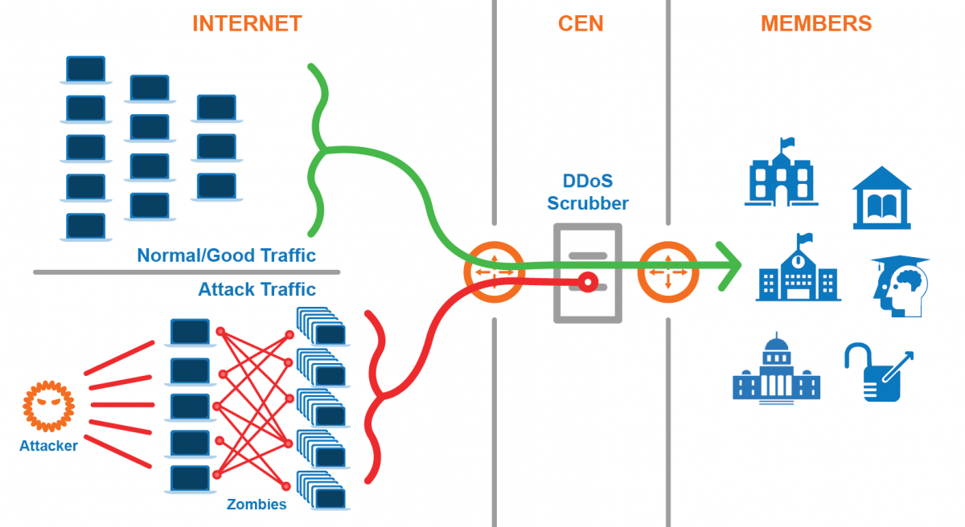
How Model Prevents DDoS

Slide 16
Model Training and Optimization
Configuration:
Optimizer: Adam with adaptive learning rate.
Loss Function: Binary cross-entropy for two-class classification.
Hyperparameters: 50 epochs, batch size of 64, dropout rate of 0.2.
Regularization: L2 normalization and dropout to prevent overfitting.

Slide 17
Comparative Project Analysis
Project Title: DDoS Attack Detection for 5G Network Slice using CNN
Source: GitHub Repo - DDoS Attack Detection for 5G Network Slice using CNN https://github.com/sajidkhan2067/DDoSAttackDetectionUsingCNN
Objective: Develop a CNN-based solution for DDoS detection in 5G network slices, achieving >99% accuracy.
Dataset: Custom 10-million-row dataset, accessible via IEEE DataPort (DoS/DDoS Attack Dataset for 5G Network Slicing).

Slide 18
Strengths and Innovations
Real-Time Capability: Sub-millisecond detection latency, optimized for 5G.
Scalability: Handles terabyte-scale traffic in CPS environments.
Adaptability: Evolves with emerging attack signatures.
Cyber Security Impact: Fortifies critical infrastructure resilience.

Slide 19
Limitations and Challenges
Data Requirements: Reliant on large, high-quality labeled datasets.
Computational Overhead: Intensive GPU resources for training and inference.
Scope Limitation: Optimized for specific DDoS variants; broader testing needed.
Network Specificity: Performance unvalidated in non-5G contexts.

Slide 20
Alignment with AML Curriculum
Core Topics:
Deep Learning: CNN, LSTM (Unit 2: Advanced Neural Networks).
Anomaly Detection: Cyber security applications (Unit 3: ML in Security).
Data Preprocessing: Feature engineering (Unit 1: Data Science Foundations).
Competencies:
Advanced model design and hyperparameter tuning.
Application of ML to solve real-world security challenges.

Slide 21
Future Research Directions
Enhancements:
Implement transfer learning for multi-attack detection.
Optimize for edge computing in CPS.
Applications:
Extend to IoT ecosystems and smart city frameworks.
Integrate with proactive intrusion prevention systems.
Innovations:
Explore federated learning for privacy-preserving detection.
Develop lightweight models for resource-constrained environments.

Slide 22
Conclusion
Summary: The research paper and project showcase pioneering deep learning solutions for DDoS detection in 5G CPS, with accuracies of 98.7% and >99%, respectively.
Contribution: Advances the field of cyber security for next-generation networks.
Takeaway: Deep learning offers a transformative approach to securing critical infrastructures in the 5G era.

Slide 23
References
Hussain, B., Du, Q., Sun, B., & Han, Z. (2021). "Deep Learning-Based DDoS-Attack Detection for Cyber–Physical System Over 5G Network." IEEE Transactions on Industrial Informatics, 17(2), 860-870. DOI: 10.1109/TII.2020.2974520.
AML Syllabus, National Forensic Sciences University, M.Tech AI & DS (Cyber Security), 2024-26.
GitHub Repository: DDoS Attack Detection for 5G Network Slice using CNN , https://github.com/sajidkhan2067/DDoSAttackDetectionUsingCNN

Slide 24


